Slide 1
Adding Contextual Data and Improving Reproducibility with R
Nathan R. Jones
Senior project director / Data scientist
University of Wisconsin Survey Center
github.com/nrjjones/BuildingContextualData
Summer DemSem 2023

Slide 2

Motivation
How can we find out more about the world?
How can we extend the utility of data we already have?
Let’s make some nice looking things
Let’s be ready to do it again!

Slide 3
We have questions
How does environment affect health?
Who lives in
a food desert?
How accessible are health services?

Slide 4




Themes
Problem solving using R, but relevant to other tools
Reproducibility
Solve problems once
Make as much as possible auditable
Real examples, not toys
Data that look like your data
Do things that you normally do with your data

Slide 5
Some words about R
R is a free, open-source statistical application
RStudio is a free, open-source GUI for R
R has lots of free, open-source helper tools called packages

Slide 6

Some words about R
We can use packages to…
Get data
Open files
Work with many data types simultaneously
Interact with websites
Make tables and maps
Save files in different formats
Bundle files in a zip
Post data to Box

Slide 7
Suggestions for this session
If you don’t know R, don’t worry!
Are the output and flexibility worth the effort for you to learn R?
SSCC has you covered:
Data Wrangling in R starting on May 30
If you do know R, here is a link to the GitHub page
github.com/nrjjones/BuildingContextualData

Slide 8

Is there another way?
What are you comfortable with?
R is a comprehensive set of tools
All of this is possible with Python
Probably possible with Stata/SAS/SPSS plus some other tools

Slide 9

Adding context the hard way
What I had planned...
Find a site with data
Scrape information from page
Clean whatever craziness that yields
Build a new database
Merge, analyze, map, etc

Slide 10


Slide 12
What else is out there?
Gas prices | https://www.gasbuddy.com/home?search=53705&fuel=1
Housing prices | https://www.zillow.com/howto/api/APIOverview.htm
Crime data | https://crime-data-explorer.fr.cloud.gov/api
Twitter | https://developer.twitter.com/en/docs/tweets/search/overview

Slide 13
What else is out there?
Gas prices | https://www.gasbuddy.com/home?search=53705&fuel=1
Housing prices | https://www.zillow.com/howto/api/APIOverview.htm
Crime data | https://crime-data-explorer.fr.cloud.gov/api
Twitter | https://developer.twitter.com/en/docs/tweets/search/overview

Slide 14
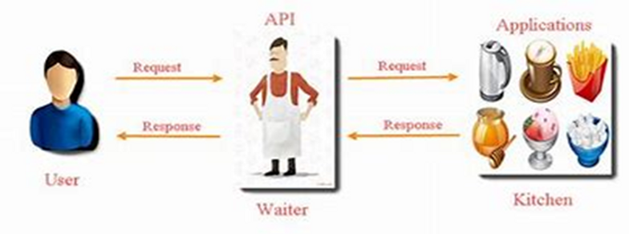
What is an API?
Application Programming Interface
Easy way to interact with data behind the website

Slide 15
For this presentation
Google Maps API
https://developers.google.com/maps/documentation
Zip Atlas
http://zipatlas.com

Slide 16
What can I do with data I already have?
Sample file with demographic and health data
ID | BMI | Zip | County | Address
1001
1002
1003
1004
1005
1006
1007
1008

Slide 17
What can I do with data I already have?
Sample file with demographic and health data
ID | BMI | Zip | County | Address
1001 | 24.8 | 53515 | Dane | 123 Road Ave
1002 | 27.2 | 53521 | Milwaukee | 678 Street Way
1003 | 28.5 | 53716 | La Crosse | 234 Avenue Cir
1004 | 32.1 | 51646 | Rock | 567 Lane Dr
1005 | 29.7 | 52305 | Green | 689 Drive Cross
1006 | 22.8 | 51149 | Ashland | 345 Highway St
1007 | 23.5 | 57903 | Door | 789 Drive St
1008 | 31.2 | 56098 | Bayfield | 456 Main Dr

Slide 18
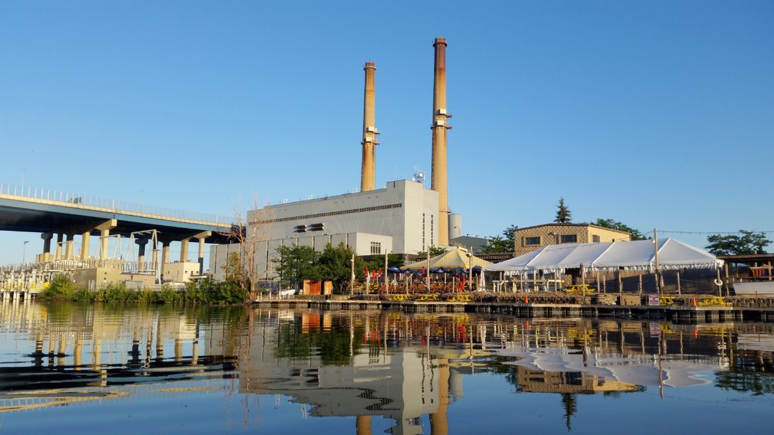
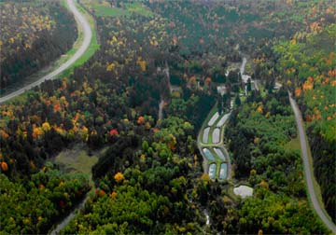
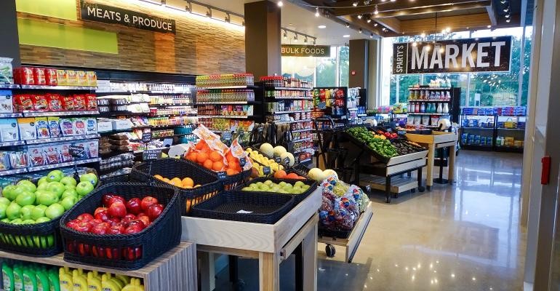
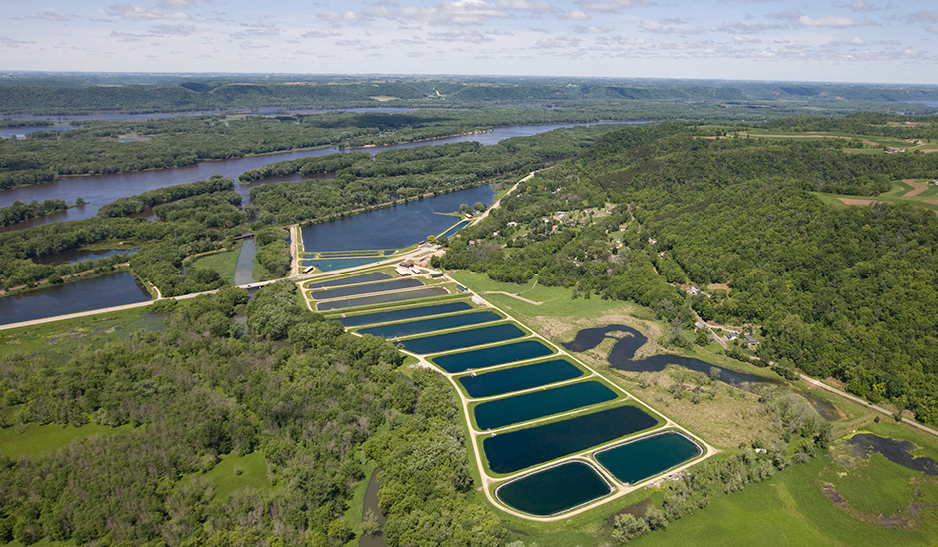
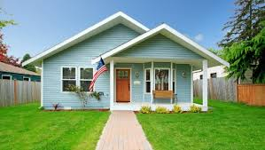
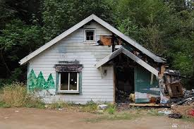
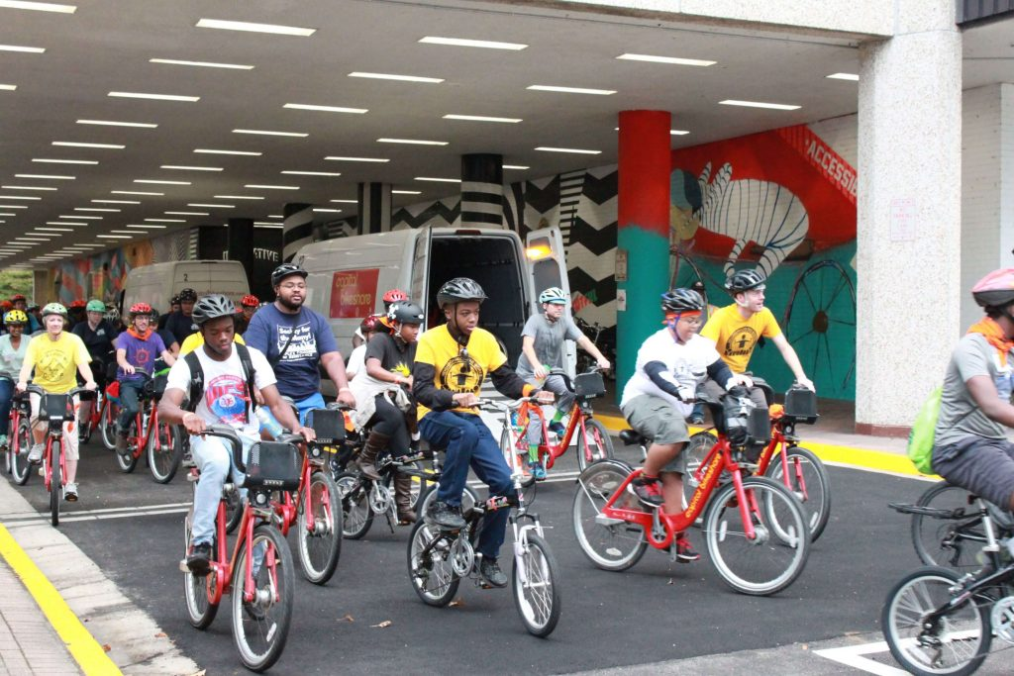

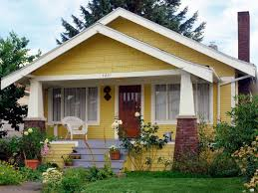
Adding contextual data

Slide 19
Adding contextual data – 3 examples
Socioeconomic environment
Find zip code level poverty rates
Access to healthy food
Find closest (presumably) higher quality food source
Health care options
Find urgent care centers within 2-mile radius

Slide 20
Adding contextual data – 3 examples
Socioeconomic environment
Standard web scrape, programmatic URL creation
Access to healthy food
Use Google API
Health care options
Use R tools that interact with Google API

Slide 21
Adding contextual data – 3 examples
Socioeconomic environment
Get zip code level poverty rates
Access to healthy food
Find closest high quality food source
Health care options
Find urgent care centers within 25 min drive

Slide 22

Example 1: Socioeconomic environment

Slide 23
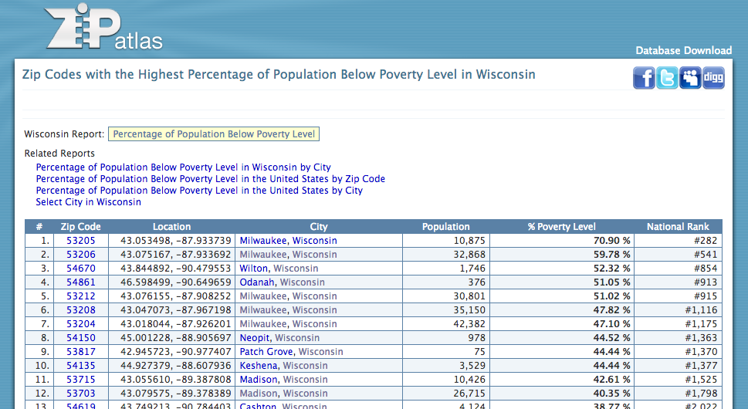
Example 1: Socioeconomic environment

Slide 24

Example 1: Socioeconomic environment
Strategy - Loop
Copy first page
Isolate table
Clean up table
Return data
Go to next page, next page, …, last page
Isolate, clean, and then append to main data

Slide 25
Example 1: Socioeconomic environment

Slide 26
Example 1: Socioeconomic environment

Slide 27
Example 1: Socioeconomic environment

Slide 28
Example 1: Socioeconomic environment

Slide 29
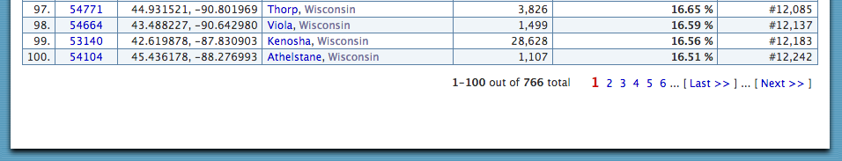
Example 1: Socioeconomic environment

Slide 30
Example 1: Socioeconomic environment

Slide 31
Function
build.zip.df <- function(x) {
tmp <- read_html(x) %>%
html_node("table") %>%
html_table(fill=TRUE)
# Clean up junk in the table
tmp <- tmp[1:7]
tmp <- tmp[-c(1:12), ]
names(tmp) <- tmp[1, ]
tmp <- tmp[-1, ]
tmp <- tmp[-c(101:105), ]
return(tmp)
}

Slide 32
Example 1: Socioeconomic environment
# Initialize data with first page
zip.df <- build.zip.df("http://zipatlas.com/wi/population-below-poverty-level.1.htm")
# Loop through rest of pages
for(i in 2:8) {
link <- paste0(”[BASE URL]", i, ".htm")
tmp <- build.zip.df(link)
zip.df <- bind_rows(zip.df, tmp)
}

Slide 33
Example 1: Socioeconomic environment
# Initialize data with first page
zip.df <- build.zip.df("http://zipatlas.com/wi/population-below-poverty-level.1.htm")
# Loop through rest of pages
for(i in 2:8) {
link <- paste0(”[BASE URL]", i, ".htm")
tmp <- build.zip.df(link)
zip.df <- bind_rows(zip.df, tmp)
}

Slide 34
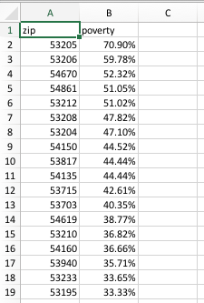
Example 1: Socioeconomic environment

Slide 35
Merge with main data
ID | BMI | Zip | County | Address | poverty
1001 | 24.8 | 53515 | Dane | 123 Road Ave | 32.6%
1002 | 27.2 | 53521 | Milwaukee | 678 Street Way | 59.2%
1003 | 28.5 | 53716 | La Crosse | 234 Avenue Cir | 35.4%
1004 | 32.1 | 51646 | Rock | 567 Lane Dr | 47.1%
1005 | 29.7 | 52305 | Green | 689 Drive Cross | 56.8%
1006 | 22.8 | 51149 | Ashland | 345 Highway St | 35.3%
1007 | 23.5 | 57903 | Door | 789 Drive St | 25.2%
1008 | 31.2 | 56098 | Bayfield | 456 Main Dr | 48.7%

Slide 36

Example 2: Access to healthy food
Find nearby healthy food sources
Get list of coop grocery stores
Get location
Address
Lat/Lon
Get other information

Slide 37
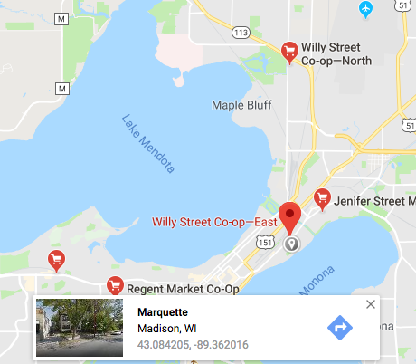
A tedious way
Search for coop grocery stores
Drop some pins in Google Maps
Copy and paste the lat/lon
(Use some other lat/lon tool)
Create a dataset
Use GIS to map

Slide 38
Create URLs with code
Structure of query is
Google API base URL +
search term +
options

Slide 39
Create URLs with code
Structure of query is
https://maps.googleapis.com/maps/api/place/textsearch/json?query=
+
“Coop grocery in Dane County”
+
Search radius
+
Google API key

Slide 40
Google Search Scrape
Use R command paste0() to combine elements
The result is a looooooong URL
https://maps.googleapis.com/maps/api/place/textsearch/json?query=Coop+grocery+in+Dane+County&radius=50000&key=AIzaSyBZqWP3nojVe3fmUcv6YlZ2l1F5tozq

Slide 41
Google Search Scrape
Use R command paste0() to combine elements
The result is a looooooong URL
https://maps.googleapis.com/maps/api/place/textsearch/json?query=Coop+grocery+in+Dane+County&radius=50000&key=AIzaSyBZqWP3nojVe3fmUcv6YlZ2l1F5tozq
I saved this loooong Google URL as a thing called Gurl

Slide 42
Google search scrape strategy
From httr package, use GET() to copy the page
From jsonlite package, convert the page to data
Save what you need from the output

Slide 43
Google search scrape in 3 terse, magical steps
From httr package, use GET() to copy the page
From jsonlite package, convert the page to data
tmp1 <- GET(Gurl)
tmp2 <- content(tmp1, "text")
tmp3 <- fromJSON(tmp2)

Slide 44
“Coop grocery in Dane County”
Name | Lon | Lat | Address
Willy Street Co-op‚ North | -89.362809 | 43.1276093 | 2817 N Sherman Ave, Madison, WI 53704, USA
Yahara River Grocery Cooperative | -89.218717 | 42.9165114 | 229 E Main St, Stoughton, WI 53589, USA
Regent Market Co-Op | -89.423402 | 43.068052 | 2136 Regent St, Madison, WI 53726, USA
Willy Street Co-op‚ East | -89.362873 | 43.0837051 | 1221 Williamson St, Madison, WI 53703, USA
Willy Street Co-op‚ West | -89.500408 | 43.0964478 | 6825 University Ave, Middleton, WI 53562, USA
Premier Cooperative Supermarket | -89.747575 | 43.140273 | 917 Mills St, Black Earth, WI 53515, USA
Jenifer Street Market | -89.351479 | 43.0903834 | 2038 Jenifer St, Madison, WI 53704, USA
Nature's Bakery Co-Op | -89.367063 | 43.081091 | 1019 Williamson St, Madison, WI 53703, USA

Slide 45
Write a function
get20results <- function(x) {
thingtosearch <- gsub(" ", "+", x)
Gurl <- paste0([ALL THE PARTS OF THE URL])
tmp <- GET(Gurl)
tmp2 <- content(tmp, "text")
tmp3 <- fromJSON(tmp2)
tmp4 <- bind_cols(
name = tmp3...name,
lon = tmp3...lng,
lat = tmp3...lat,
address = tmp3...formatted_address
)
return(tmp4)
}

Slide 46
Concept review
If you have places, even roughly operationalized...
You can get a list of results from Google
You can get coordinates
You can get addresses
You can get open hours, ratings, etc

Slide 47
Quick aside
Location data the easy way!
Great tools that interact with Google already exist
R package ggmap does a lot!
Following examples will use several functions
geocode()
mapdist()
get_map()
ggmap()

Slide 48
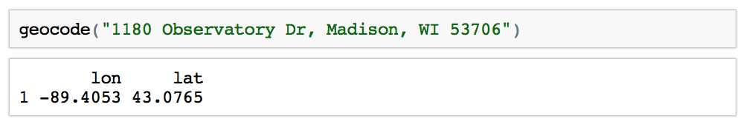
Location data the easy way!
ggmap’s function geocode()
It just works!

Slide 49
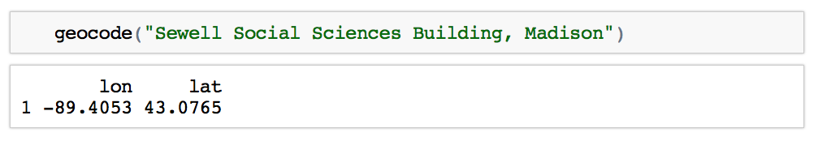
Location data the easy way!
ggmap’s function geocode()
And it can figure this out

Slide 50
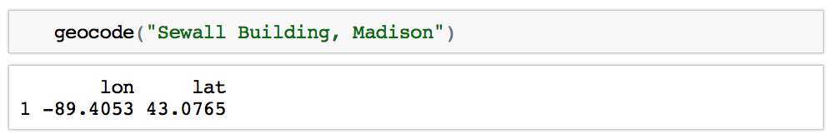
Location data the easy way!
ggmap’s function geocode()
And because we live in the future!

Slide 51
Mass geocoding the easy way
buildings <- read_csv(“List of 200 buildings.csv”)
geocoded_buildings <- geocode(buildings$name)
name | Lat | Lon
Building 1
Building 2
…
Building 200

Slide 52

Example 3: Health care options
So, now we know how to get location information from a search
Let’s create some relevant data
Distance to closest coop grocery
Distance to health care services
Density of health care services

Slide 53
Review function
get20results <- function(x) {
thingtosearch <- gsub(" ", "+", x)
Gurl <- paste0([ALL THE PARTS OF THE URL])
tmp1 <- GET(Gurl)
tmp2 <- content(tmp1, "text")
tmp3 <- fromJSON(tmp2)
tmp4 <- bind_cols(
name = tmp3...name,
lon = tmp3...lng,
lat = tmp3...lat,
address = tmp3...formatted_address
)
return(tmp4)
}

Slide 54
Use the function
Get the first 20 matches to any Google Map search
co <- get20results("Coop grocery in Madison")
NOTE You can get more than 20 by repeating the search and adding a token returned with the first search.

Slide 55
How far is it to nearest coop?
Use the mapdist() function to get travel distances, duration, other details, by mode!
from <- df$address
to <- co$address[1]
dist1 <- mapdist(
from,
to,
mode="bicycling",
output="simple”
)

Slide 56
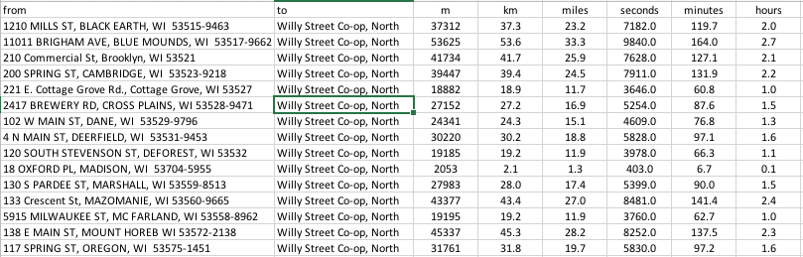
Results from mapdist()

Slide 57
Strategy for finding closest coop
Use mapdist() to get distance from each address to each coop
Make a long file of all results
Sort by address, then distance
Save the first result for each address and drop the rest
The result is the distance to the closest coop
Rename the variable to closest
Drop unneeded variables
Merge the closest into main data

Slide 58
dplyr makes it easy
Reproducible data transformations
Literate so others can tell what you did
Creates an audit trail
Feels slower than “just doing it in Excel” at first, but pays off in the long run

Slide 59
dplyr makes it easy
closest <- dist %>%
arrange(from, miles) %>%
group_by(from) %>%
filter(row_number()==1) %>%
select(from, to, miles) %>%
transmute(
address = from,
name_closest_coop = to,
dist_closest_coop = miles
)

Slide 60
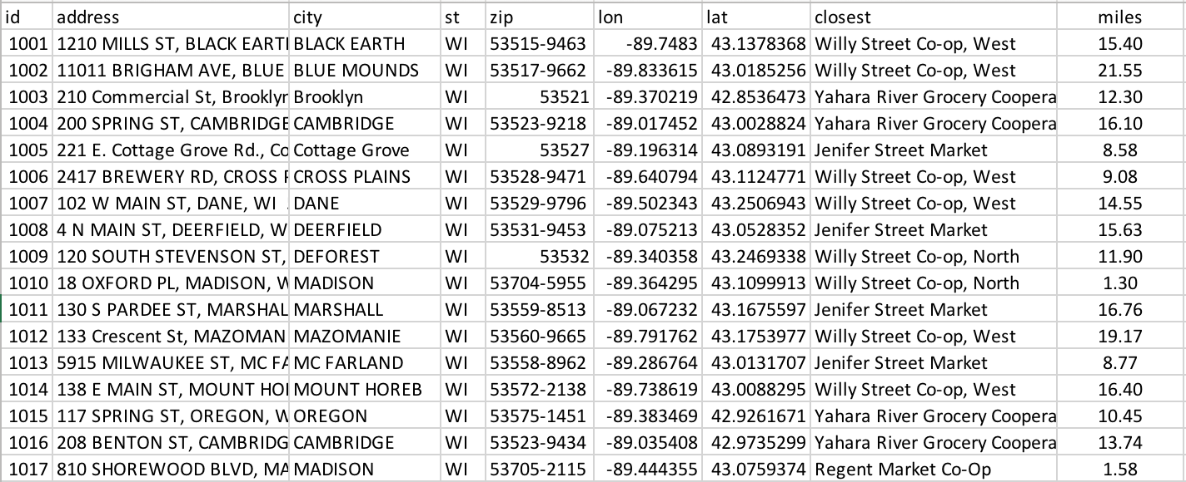
Merged into main data

Slide 61
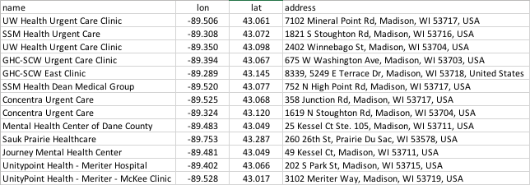
Search results…
uc <- get20results(”Urgent care center in Dane County")

Slide 62
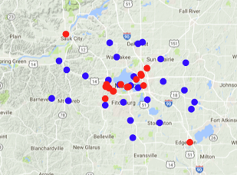
Map results…

Slide 63
dplyr to count urgent care within 25 mins
within25mins <- dist %>%
arrange(from, minutes) %>%
group_by(from) %>%
filter(minutes < 25) %>%
transmute( uc_num = n() ) %>%
group_by(from) %>%
filter(row_number()==1)

Slide 64
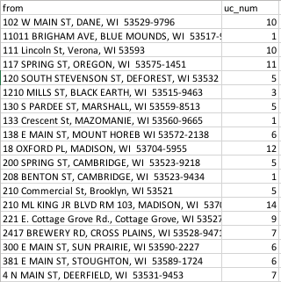
Merge results back into main data

Slide 65
Concept review
You can search the Google API for anything
You can automate a lot of the steps
You can extract a lot of information from the results
You can add new data and make maps

Slide 66
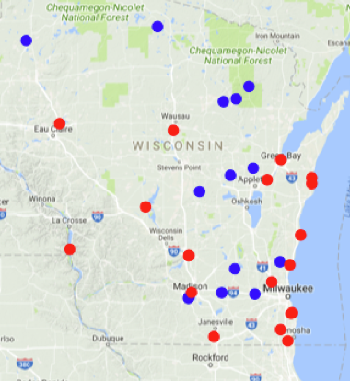
Really anything…
Use the function for a research question
pp <- get20results(”Power plants in WI")
hs <- get20results(”Fish hatcheries in WI")

Slide 67
Another example…
pp <- get20results("Planned Parenthood clinics in Atlanta")
hs <- get20results("Private high schools in Atlanta")

Slide 68
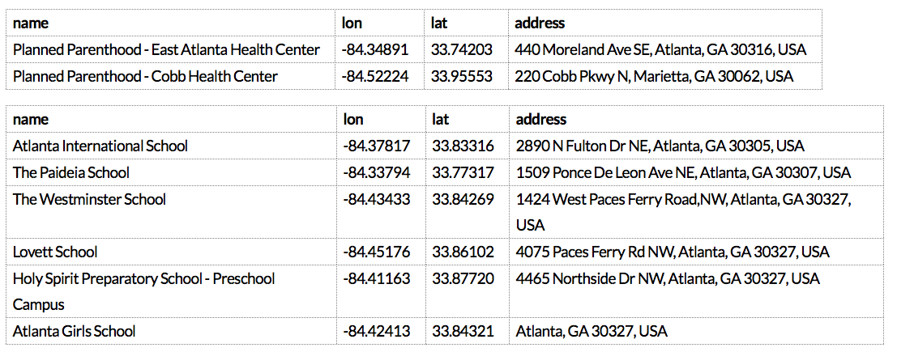
How far are reproductive health services?

Slide 69
Mapping is easy too
mdata <- get_map(location = "Atlanta, GA",
color = "color",
source = "google",
maptype = "terrain",
zoom = 10)
ggmap(mdata,
extent = "device",
ylab = "Latitude",
xlab = "Longitude") +
geom_point(data=pp, aes(x = lon, y = lat), color="red") +
geom_point(data=hs, aes(x = lon, y = lat), color="blue")

Slide 70
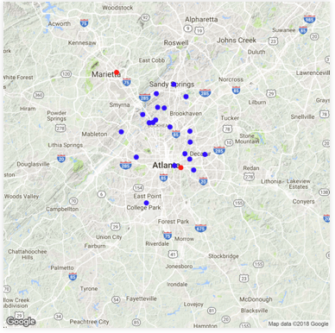
High schools and Planned Parenthoods

Slide 71
Another neat opportunity

Slide 72
Another neat opportunity
Combine your pocket GPS data logger with ggmap and Google API
Scrape EXIF data from your photos
Map!
image_files <-list.files("~/California")
tmp <- read_exif(image_files, tags=c("FileName", "GPSLatitude", "GPSLongitude"))

Slide 73
Another neat opportunity
The command list.files() created a list of ~1500 pictures by searching a folder on my desktop.
read_exif() from the exifr package extracted the lat and lon tags from my photos.
This took ~5 seconds.
And then…
brews <- getContext("Breweries in Berkeley, CA")

Slide 74
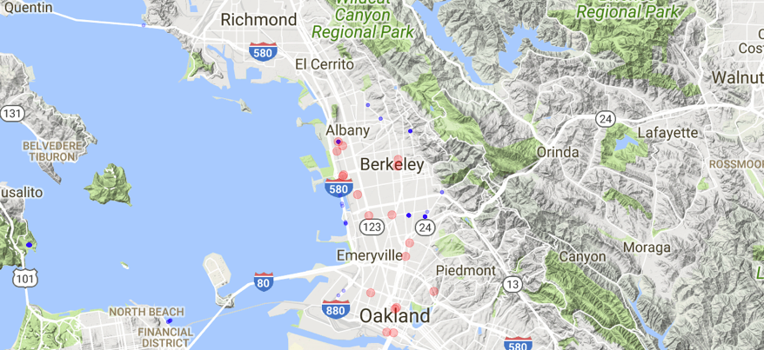
ggmap(mdata,extent = "device", ylab = "Latitude",xlab = "Longitude") +
geom_point(data=photos, aes(x = GPSLongitude, y = GPSLatitude), color="blue") +
geom_point(data=brews, aes(x = lon, y = lat), color="red")

Slide 75
Cautions
Google makes you enter credit card info to get API key
Free queries to Google API limited to 1500 per day
Example: 2000 addresses x 20 coops = 40,000 queries – Careful!
Get API key here:
https://console.cloud.google.com/apis/
Use register_google(key = “YOUR KEY”)
Be careful with the key if you are using GitHub or other online version control.

Slide 76
A few more reproducible examples
Client sends sample file:
List for UWSC 3-6-2022 FINAL V03.xlsx
Contains names, emails, and other sample vars.
...in 3 sheets
...in different formats

Slide 77
Just fix it in Excel or write code?
Name | Email | Group | Title
JANE DOE | jane.doe@gmail.com | A | Faculty
…
Sam Jenkins | sjenkins@yahoo.com | C | Staff
Phil Roberts | Phil.Roberts@msn.com | B | Faculty
…
ZHANG, BAO | zhang@wisc.edu | C | Staff
MCDONALD, RON | clowninaround@me.com | D | Faculty
COSTA DE SILVA, VERA | B | vcosta@gmail.com | Faculty
…
JOHN SMITH III | jsmith@yahoo.com | C | Staff
Jane Doe | jane.doe@gmail.com | A | Faculty

Slide 78
Lots of formatting fixes
Issue | sample_clean.R
Fix capitalized names | str_to_title()
Fix Last, First formatted names by looking for names with commas | str_split(name, “,”)
Fix McXxx, O’Xxxx names | str_detect(last_name, “^[O]”) str_detect(last_name, “^Mc”)
Fix Costa de Silva, de la Cruz, Fond du Lac, Prairie du Sac, etc | str_replace(last_name, “De”, “de”)
Fix Iii, JR, etc | str_replace(last_name, “Iii”, “III”)
Fix swapped columns | str_detect(email, “@”)
Check for duplicates | group_by(email) %>% mutate(n=n()) %>% filter(n>1)

Slide 79
Was it worth it?
Client sends ...FINAL V03 update.xlsx the day before launch!
Do you remember all the fixes you made 3 weeks ago?
Future you will be happy for sample_clean.R

Slide 80
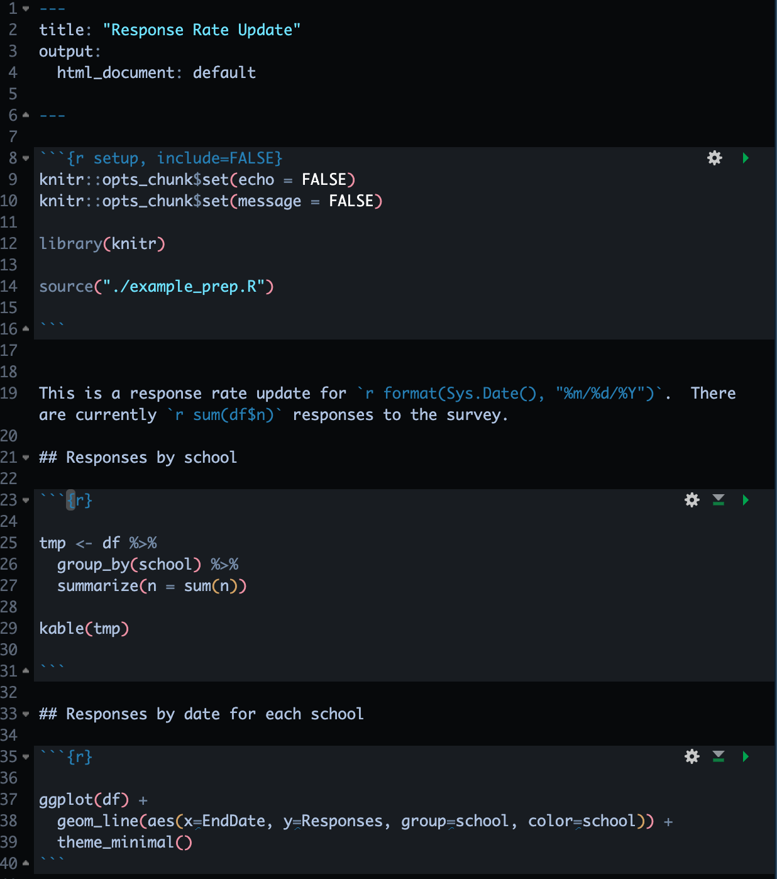
Rmarkdown (and Quarto)
Allows you to integrate analyses and output in a literate way
Embed code in text
Publish to HTML, PDF, Word, PowerPoint
Update data sources and repeat
Automate uploading to Box with boxr package
box_auth()
box_ul(
dir_id = 172205382345,
"./out/Response Update.pdf"
)

Slide 81
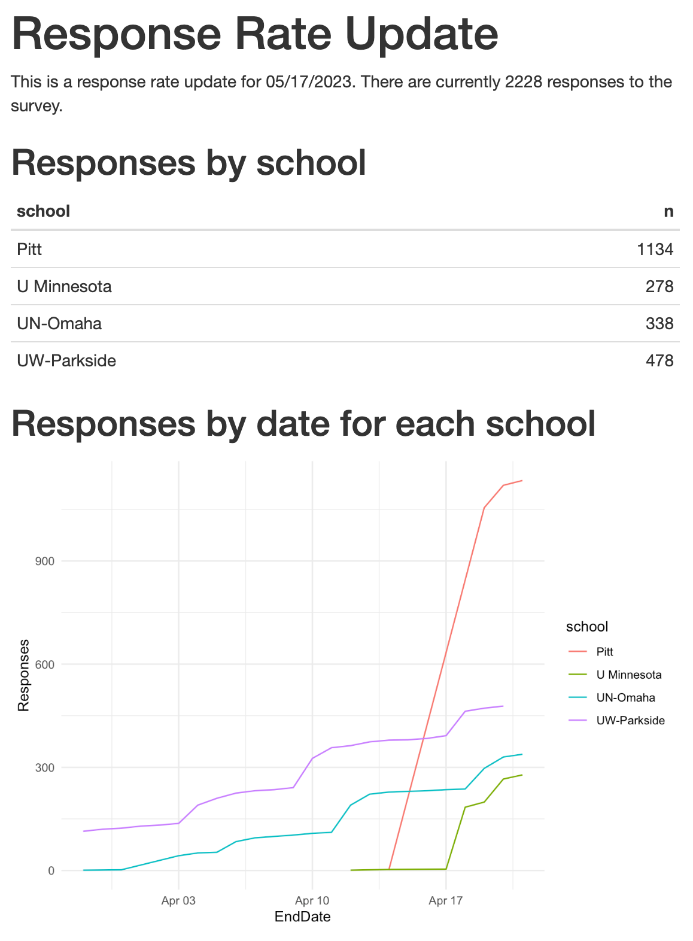
Rmarkdown (and Quarto)
Allows you to integrate analyses and output in a literate way
Embed code in text
Publish to HTML, PDF, Word, PowerPoint
Update data sources and repeat
Automate uploading to Box with boxr package
box_auth()
box_ul(
dir_id = 172205382345,
"./out/Response Update.pdf"
)

Slide 82
If time allows, switch to R

Slide 83
Thank you!
Reminder
Data Wrangling in R starting on May 30
GitHub page for this presentation.
github.com/nrjjones/BuildingContextualData

